Slide 1
Basics of Neuroanesthesia
Arthur M Lam MD, FRCPC, FNCS
Clinical Professor of Anesthesiology
Attending Neurointensivist
University of California, San Diego

Slide 2
CBF = 50 ml/100 gm/min
CMRO2 = 3.2 ml/ 100 gm/ min
AVDO2 = 6.4 vol %
SjvO2 = 65 – 70%

Slide 3
Regulation of Cerebral Blood Flow
Flow-Metabolism Coupling
Pressure Autoregulation metabolic (adenosine?) myogenic
Chemical Control CO2/O2
Neurogenic?

Slide 4
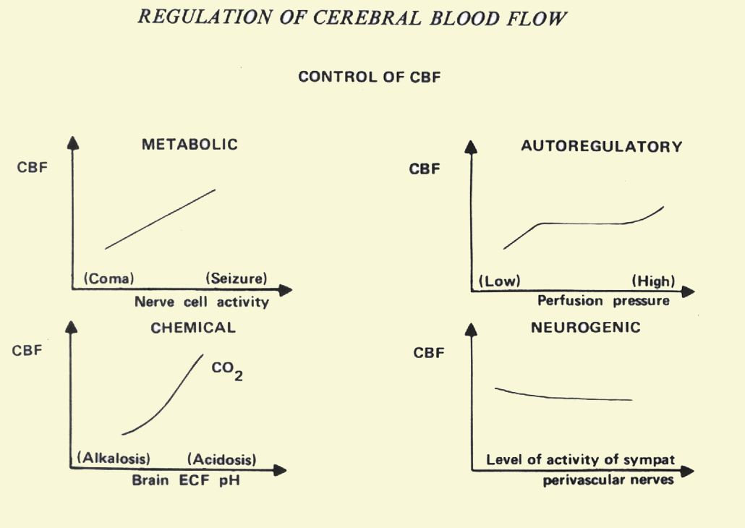

Slide 5
Flow-metabolism Coupling

Slide 6
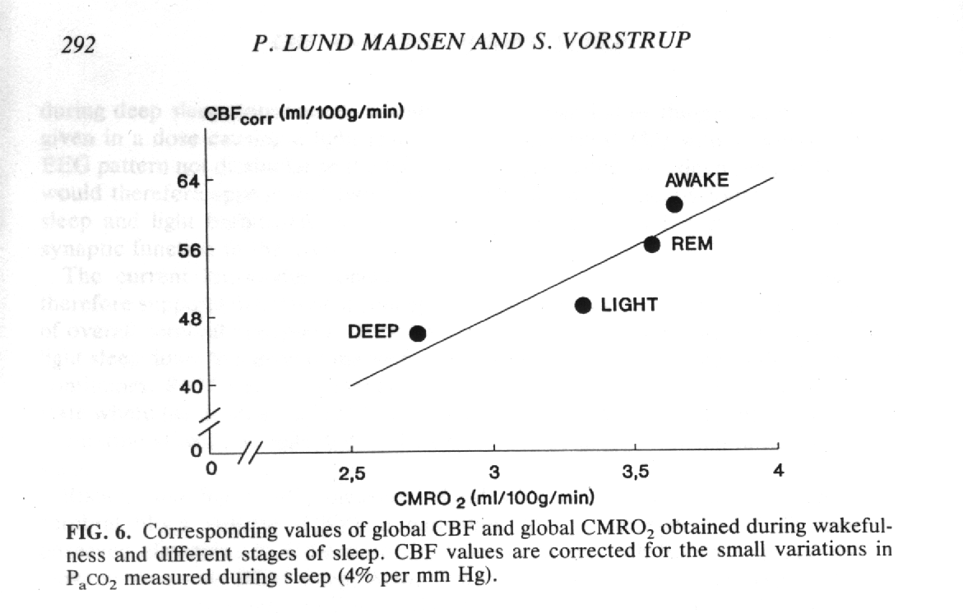
CBF during different stages of sleep
From Madsen and Vorstrup Cerebrovas Brain Metab Review 1991

Slide 7
Cerebral Autoregulation

Slide 8
Cerebral Autoregulation
CBF
60 160
Blood Pressure (mmHg)

Slide 9
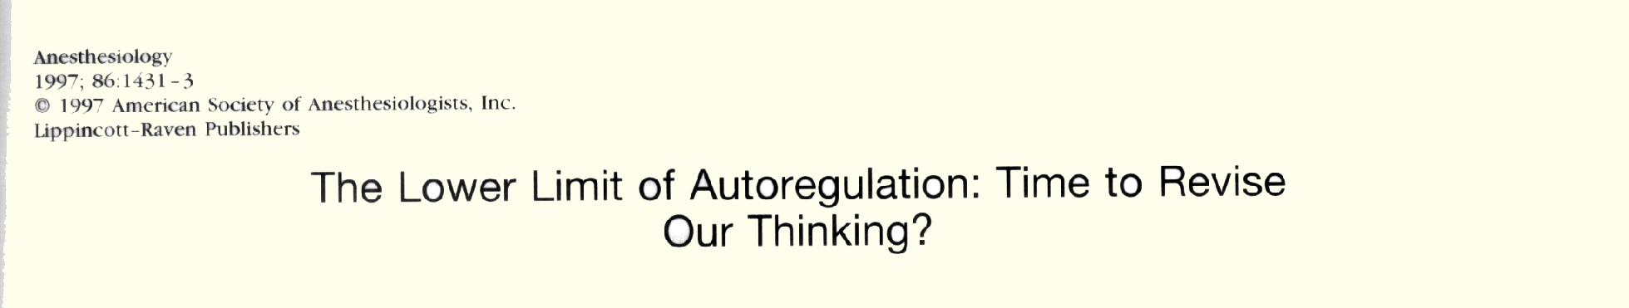
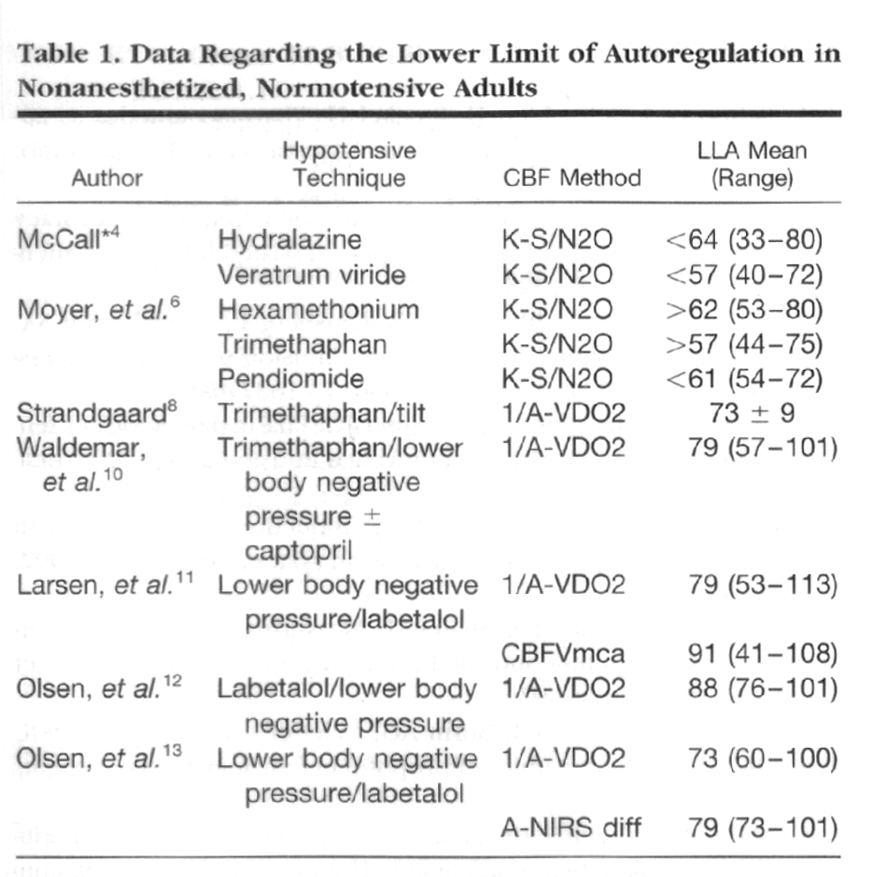
Drummond JCAnesthesiology 86:1431, 1997

Slide 10
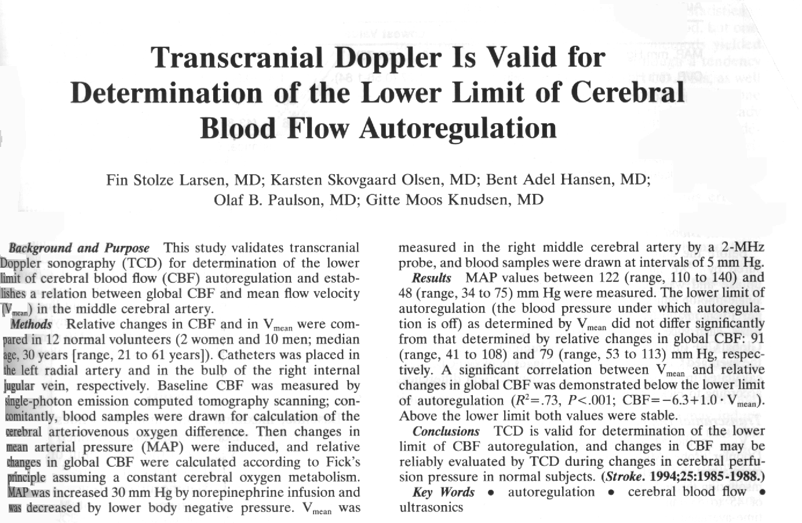

Slide 11
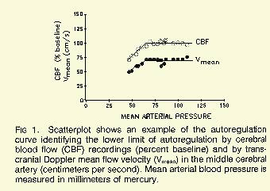
Larsen et al Stroke 10:1985-1988,1994

Slide 12
Inhaled Agents and CBF
Influence of flow-metabolism coupling

Slide 13
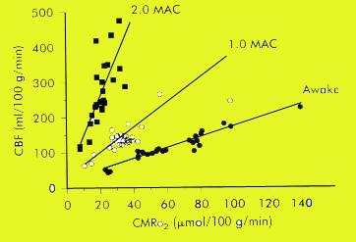
Isoflurane

Slide 14
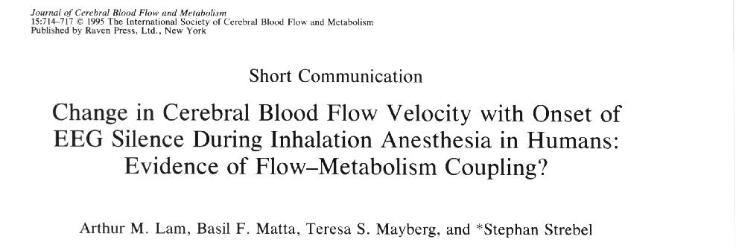

Slide 15
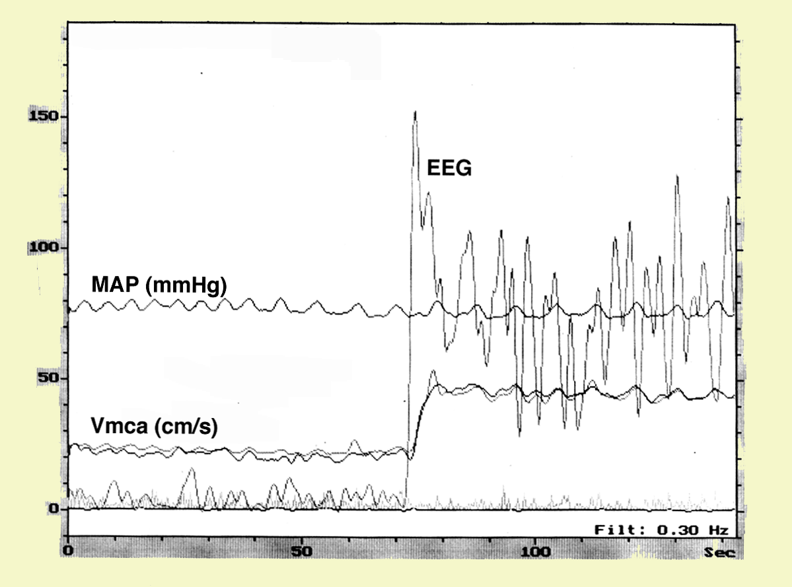
Change in Flow Velocity with EEG activity
during High Dose Isoflurane Anesthesia

Slide 17
Halothane
CBF
Isoflurane
Sevoflurane
1
2
3
MAC

Slide 20
Conclusions: Both anesthetic agents caused a global reduction of rCBF (propofol > sevoﬂurane) at the 1 MAC/EC50 level. The effect was maintained at higher propofol concentrations, whereas 2 MAC sevoﬂurane caused noticeable ﬂow redistribution.
Kaisti et al Anesthesiology 2002

Slide 21
Effects of Nitrous Oxide on Global and
Regional Cortical Blood Flow
Deutsch and Samra Stroke 1990
150
Percentage of baseline CBF
100
21%O₂
100%O₂
25%N₂O
75%N₂O

Slide 22
INHALATION ANESTHETICS
Dual Action Hypothesis
Direct: Vasodilation
Indirect: flow-metabolism coupled
vasoconstriction
• halothane
• isoflurane
• desflurane /sevoflurane
• Nitrous oxide

Slide 23
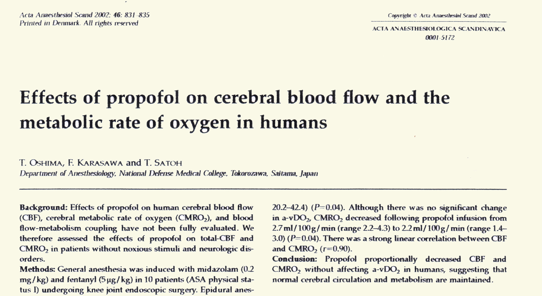
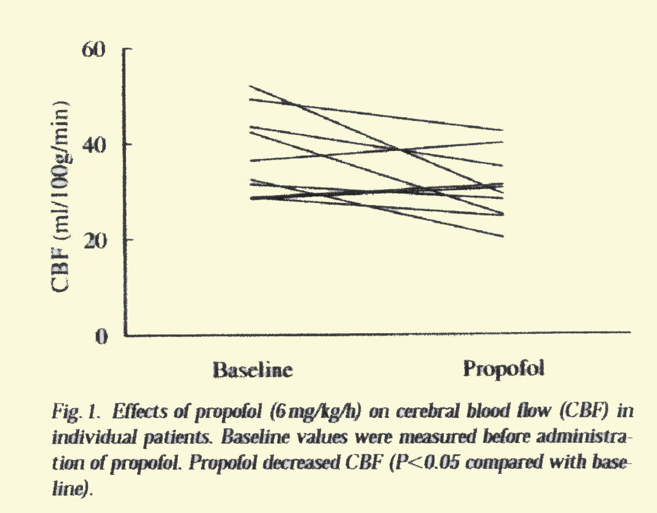
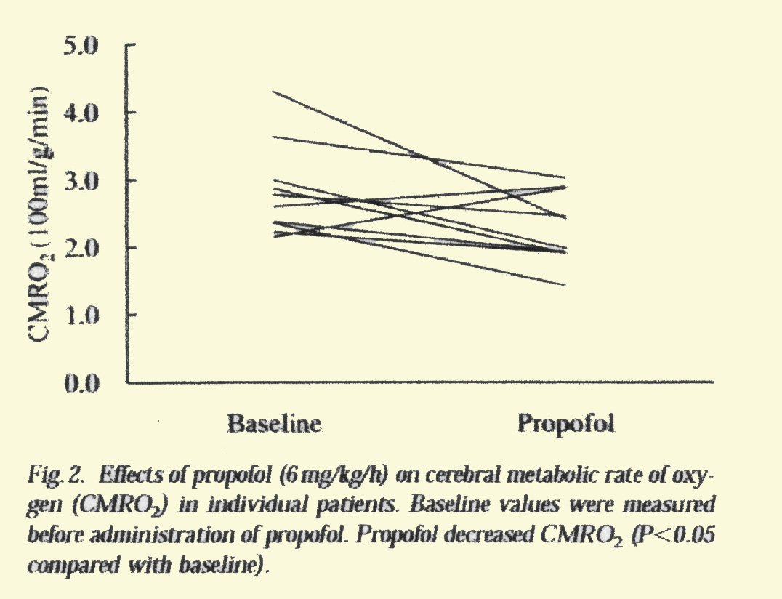

Slide 25
Influence of Inhalation Agents on Autoregulation
High dose
Moderate dose
Low dose
CBF
Normal
Blood Pressure

Slide 26
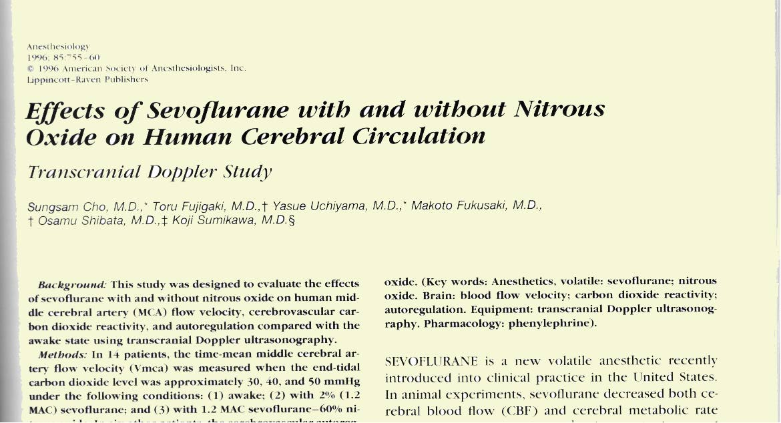

Slide 27
Autoregulation during sevoflurane anesthesia
100
80
60
Vmca
(cm/s)
40
20
0
80 110
MAP (mmHg)
From Cho et al Anesthesiology 1996

Slide 28
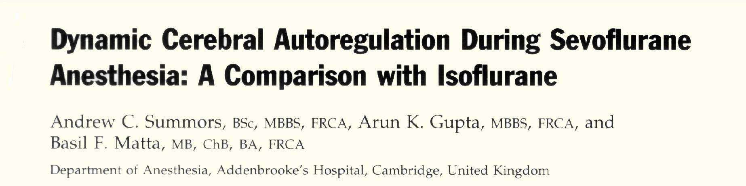
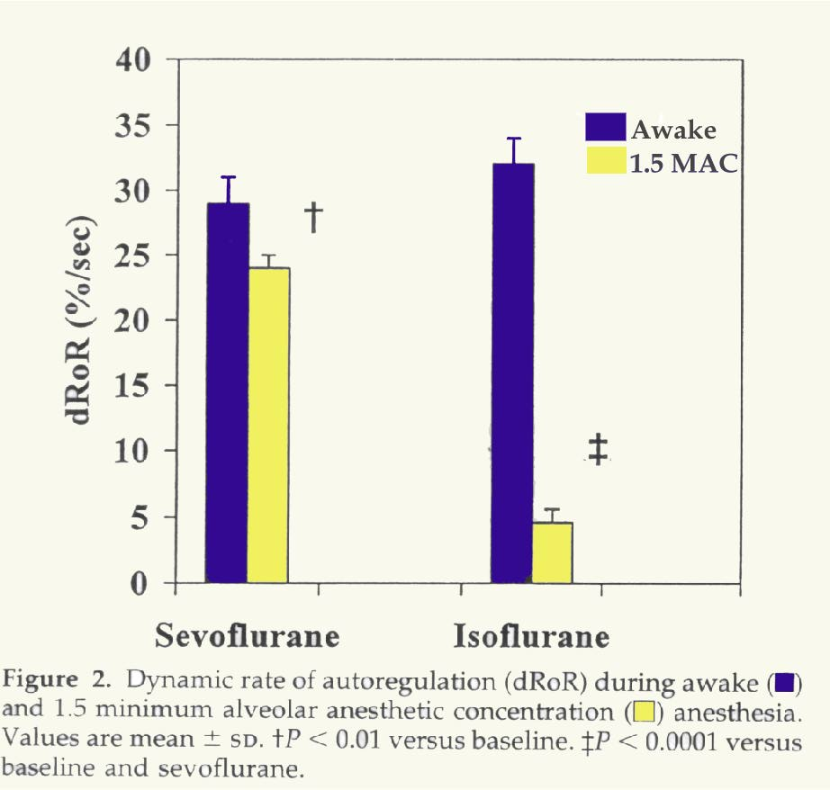

Slide 29
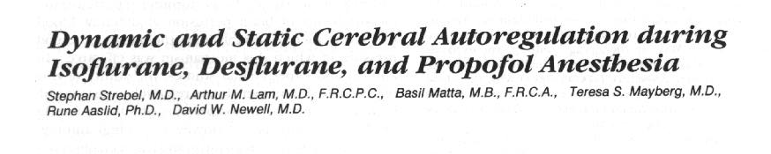
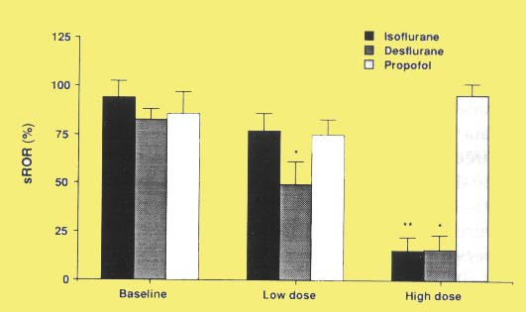

Slide 30
CO₂ Reactivity

Slide 31
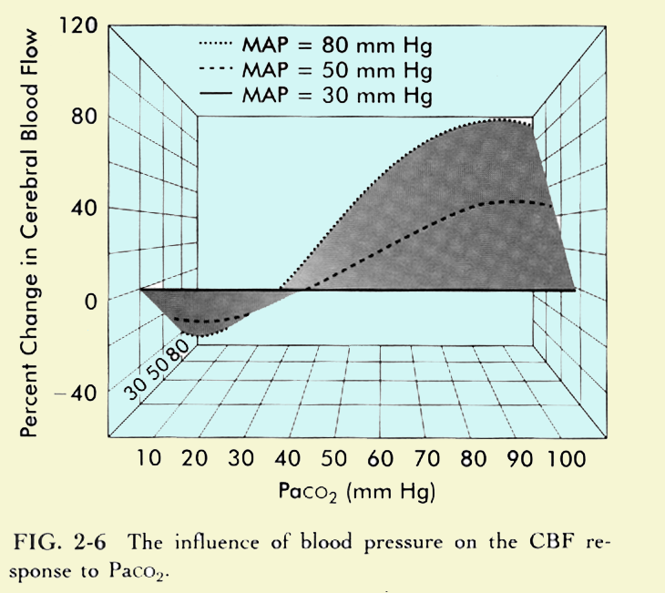

Slide 32
CO₂ reactivity is preserved during both inhalation and intravenous anesthesia

Slide 33
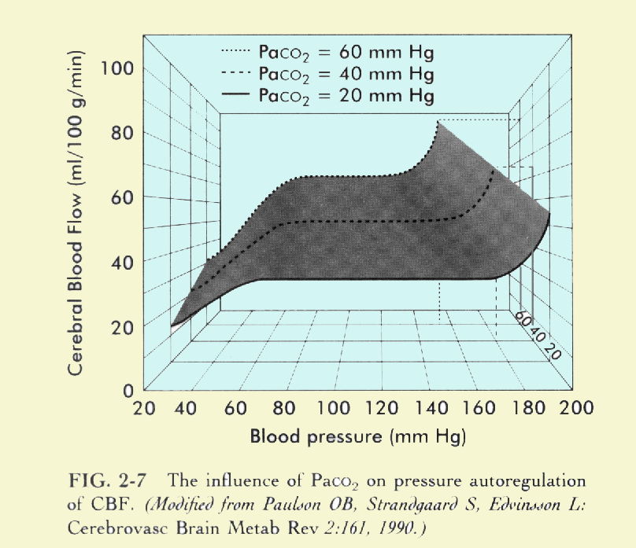

Slide 34
Influence of Graded Hypercapnia on Cerebral Autoregulation during Propofol and Sevoflurane Anesthesia
Hypothesis: Anesthetics may influence the interaction between PaCO₂ and autoregulation
Methods: 8 ASA-I Patients scheduled for lower extremity
orthopedic surgery for >6 hours
Randomized, cross-over design
Sevoflurane 1.1% end-tidal or propofol 100 µg/kg/min+ remifentanil infusion
Autoregulation assessed at increasing levels of PaCO₂ of 40, 50, 55, 60, 65 mmHg using TCD

Slide 35
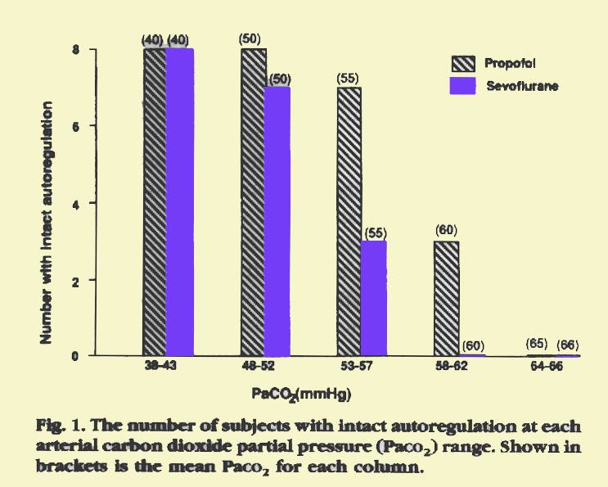
McCulloch, Visco, Lam Anesthesiology 93: 2000

Slide 36
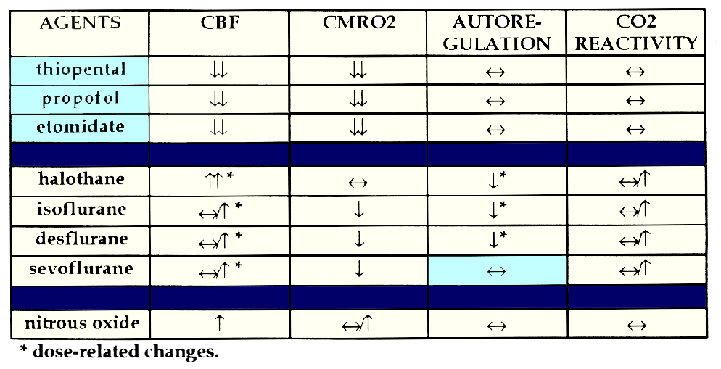
Cerebral Actions of Commonly Used Anesthetic Agents

Slide 37
Cerebral Perfusion Pressure (CPP)
CPP = MAP – ICP
or = MAP - CVP

Slide 38
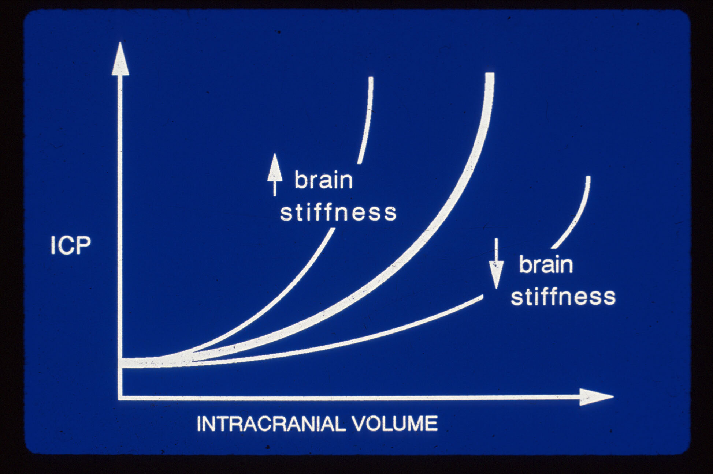
Apparent increase in intracranial volume

Slide 39
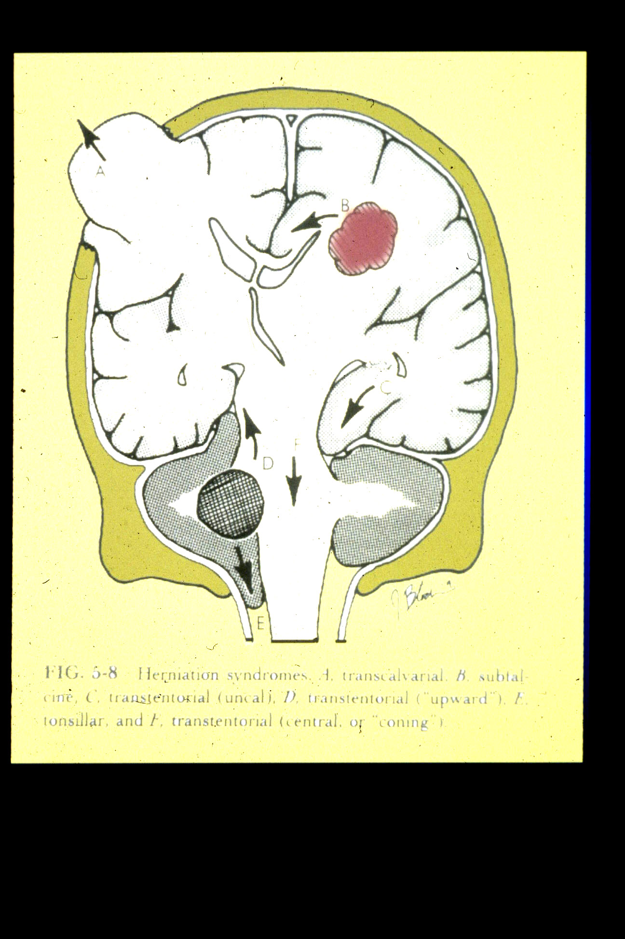

Slide 40
Treatment of h ICP
Brain mannitol, lasix, lobectomy, hypertonic saline
CSF ventriculostomy drainage
Blood hypervent. (temp.), head elevation, barbiturates
Mass surgical evacuation
Hypothermia
Decompressive Craniectomy

Slide 41
Fluid Management
Crystalloid Vs Colloid ?

Slide 42
Crystalloids vs Colloids
Osmotic press. more important than oncotic press
With significant disruption of BBB, osmotic press. may be important
Hypertonic saline may be useful
Colloid use remains controversial

Slide 43
Osmolarities of common IV solutions
Solution Osmolarity
0.9% n saline 308
Lactated Ringers 273
Plasma-lyte 294
20% mannitol 1098
3% saline 1025
5% albumin 295
6% hetastarch 310

Slide 44
The value of experience is not in seeing much, but in seeing wisely
Sir William Osler

